Slide 1
Composite and Command Pattern
Lutfun Nahar Lota
Lecturer, CSE

Slide 2
Composite pattern
Composite pattern is used where we need to treat a group of objects in similar way as a single object.
Composite pattern composes objects in term of a tree structure to represent part as well as whole hierarchy.
This type of design pattern comes under structural pattern as this pattern creates a tree structure of group of objects.
This pattern creates a class that contains group of its own objects. This class provides ways to modify its group of same objects.

Slide 3
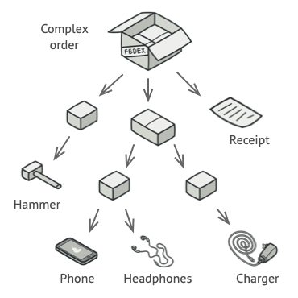
Composite pattern

Slide 4
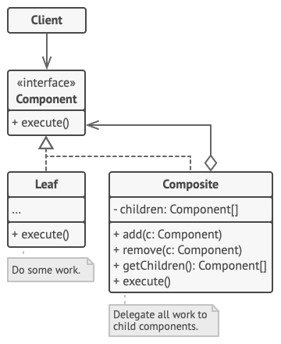
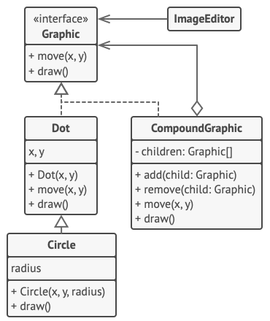
Composite pattern

Slide 5
Composite Pattern
New line() new square() composite(line, square)

Slide 6
Command Pattern
Command pattern is a data driven design pattern and falls under behavioral pattern category.
A request is wrapped under an object as command and passed to invoker object. Invoker object looks for the appropriate object which can handle this command and passes the command to the corresponding object which executes the command.

Slide 7
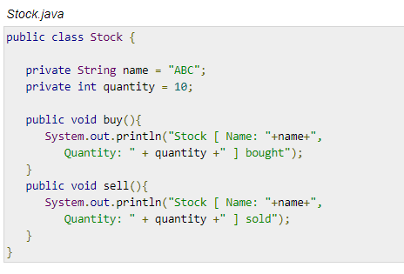
Command Pattern

Slide 8
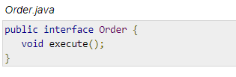
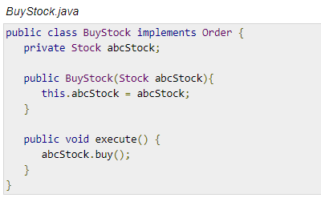
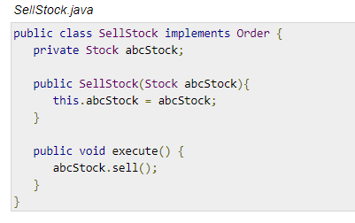
Command Pattern

Slide 9
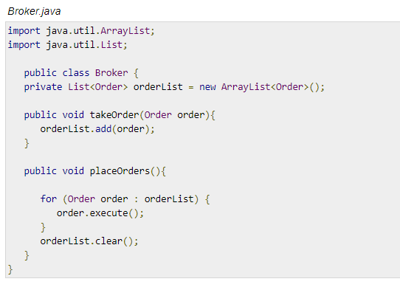
Command Pattern

Slide 10
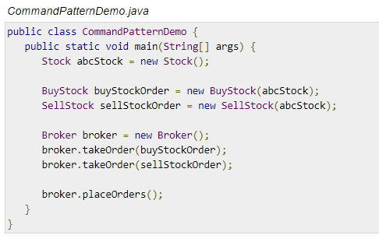
Command Pattern

Slide 11
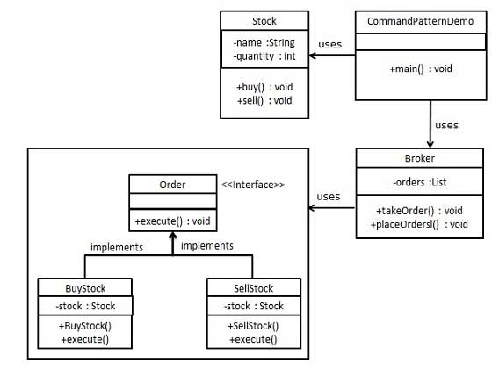
UML Command Pattern

